Slide 1
Alternative Text for Images
Maintaining ADA Title II Compliance

Slide 2
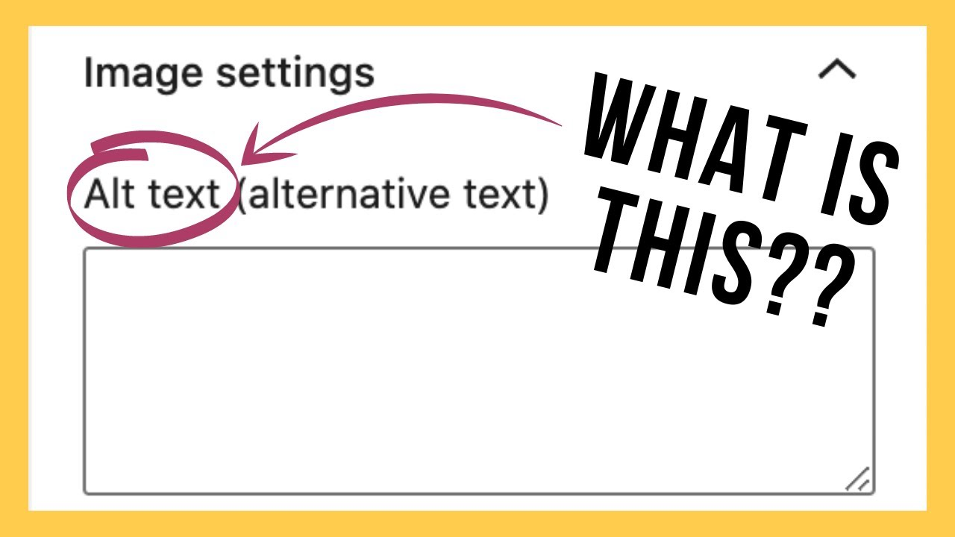
What is Alternative Text?
Alternative (Alt) Text is a brief text description of images and graphics, and is an essential part of making content accessible. When adding images, icons or other graphic elements to digital content, be sure to add alt text so that your content will be accessible to all users.
Atl Text: A text box with the circled caption “Alt Text, what is this?”
Alt text is a requirement for all digital images under the new ADA Tile II Regulations (2024)

Slide 3
Alt Text Best Practices
Keep it short, usually 1-2 sentences. Do not overthink it.
Focus on the key elements of why you chose the image, do not describe every little detail.
Do not say “image of” or “picture of.”
Do say if it is a logo, illustration, painting, cartoon, or diagram.
Always end the alt text sentence with a period.

Slide 4


Photographs
For photographs consider the specifics included in the image, such as names, proper nouns, locations, or action words. Consider why you have chosen that particular image and what you hope it will convey to your audience.
Example 1
Example 2
Atl Text: Group of young college students talk and walk in front of trees.
Atl Text: Shepherd University’s Scarborough Library with flowers in bloom.

Slide 5



Example 2
Icons
For icons consider the purpose of the icon — whether it is to share a logo, to indicate an available action, or to serve as a link to a new page.
Example 1
Example 3
Atl Text: Shepherd University Logo.
Atl Text: Print the course syllabus.
Atl Text: Visit the Shepherd University Instagram.

Slide 6
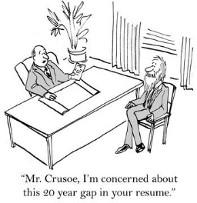

Illustrations
For creative illustrations, the intent of the image matters more than the specific details. If there is text included (such as in a cartoon or screenshot of an application) describe both relevant visuals and the relevant text.
Example 1
Example 2
Atl Text: Cartoon of a business man seated behind a desk interviewing a candidate in a suit who has scruffy hair and a long white beard. Text below reads "Mr. Crusoe, I’m concerned about this 20 year gap in your resume.”
Atl Text: Illustration of a business person in a bright yellow suit sipping coffee. Instead of a head there is a swirl of ideas and objects.

Slide 7
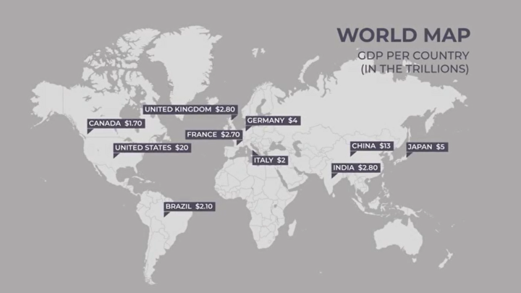
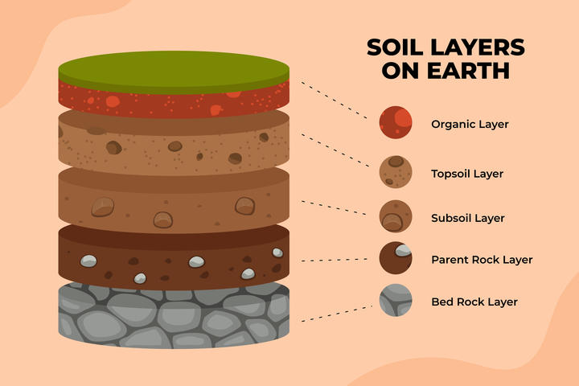
Diagrams
For diagrams and other images that aim to share specific data points, consider if you can summarize in a sentence or two the graphic’s key meaning and data points. For complex images, you may want to supplement with adjacent page text and/or a link to the full data.
Example 1
Example 2
Atl Text: Diagram of Soil Layers on Earth, from top going down: organic layer, topsoil layer, subsoil layer, parent rock layer, and last bedrock layer.
Atl Text: World Map of GDP per country in the Trillions. From most to least: US $20, China $13, Japan $5, Germany $4, India $2.80, UK $2.80, France $2.70, Brazil $2.10, Italy $2, and Canada $1.70.

