Slide 1
Digital Access for All
A Guide to ADA Title II Compliance

Slide 2
What is Title II?
Title II of the Americans with Disabilities Act requires public institutions to provide equal opportunities to people with disabilities in all their operations.
There were no previous mandates related to digitally accessible content. The 2024 regulations now require digital content to meet the Web Content Accessibility Guidelines Version 2.1 (WCAG).
Shepherd University has until April 26, 2027, to meet Title II compliance.

Slide 3

Why Does Digital Accessibility Matter?
It is inclusive and gives access to all
It promotes usability
It shows growth & innovation
It is now legally required

Slide 4
Everyone has a role
Faculty | Staff/Admin | Students
All digital documents (syllabi, handouts, rubrics, etc.) PowerPoint slides Images included in Brightspace, slides, and/or readings Video content Audio content All PDFs | Web content Social media posts Software and apps Staff/faculty trainings University forms | Digital content created in a student job Digital content created for a University sponsored student organization A Student's individual Coursework does not need to be made accessible

Slide 5
Accessible Course Materials

Slide 6





P.O.U.R. enough for all
Perceivable
Content is available to users via sight, hearing, and/or touch
Operable
Content is keyboard accessible and navigable
Understandable
Content is readable with clear labels and instructions
Robust
Content works with a variety of devices and browsers

Slide 7
Documents and Slides- Basics
Files have a title that is relevant to the content of the document.
All text is in the same, easy to read font.
Text is readable in size: 12-point font is best (unless a student receives the accommodation of Enlarged Print with a specific font size).
Bold text for emphasis, not all capital letters.
Lists are created using the bullets feature.

Slide 8



Documents and Slides- Specifics
Documents
Headings are used within the Styles feature.
Tables have headers and columns have headings
Presentations
Each slide has a title unique to that slide.
Images include alternative text.
There is sufficient color contrast.
Excel
All worksheets have a unique name.
Cell A1 contains title of worksheet or location of data.
Rows and Columns have labels.

Slide 9
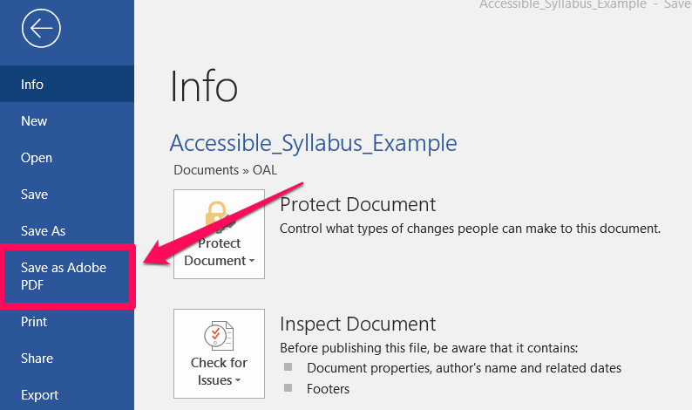
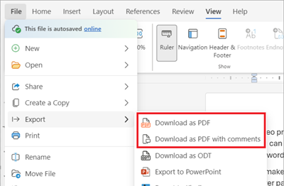
PDFs
PDFs are not recommended for accessible materials.
Consider sharing the original file type if you can.
Make the source document accessible.
Make your documents accessible in Word, PowerPoint, , Good Docs, etc.
Save it as a PDF, not "Print to PDF."

Slide 10
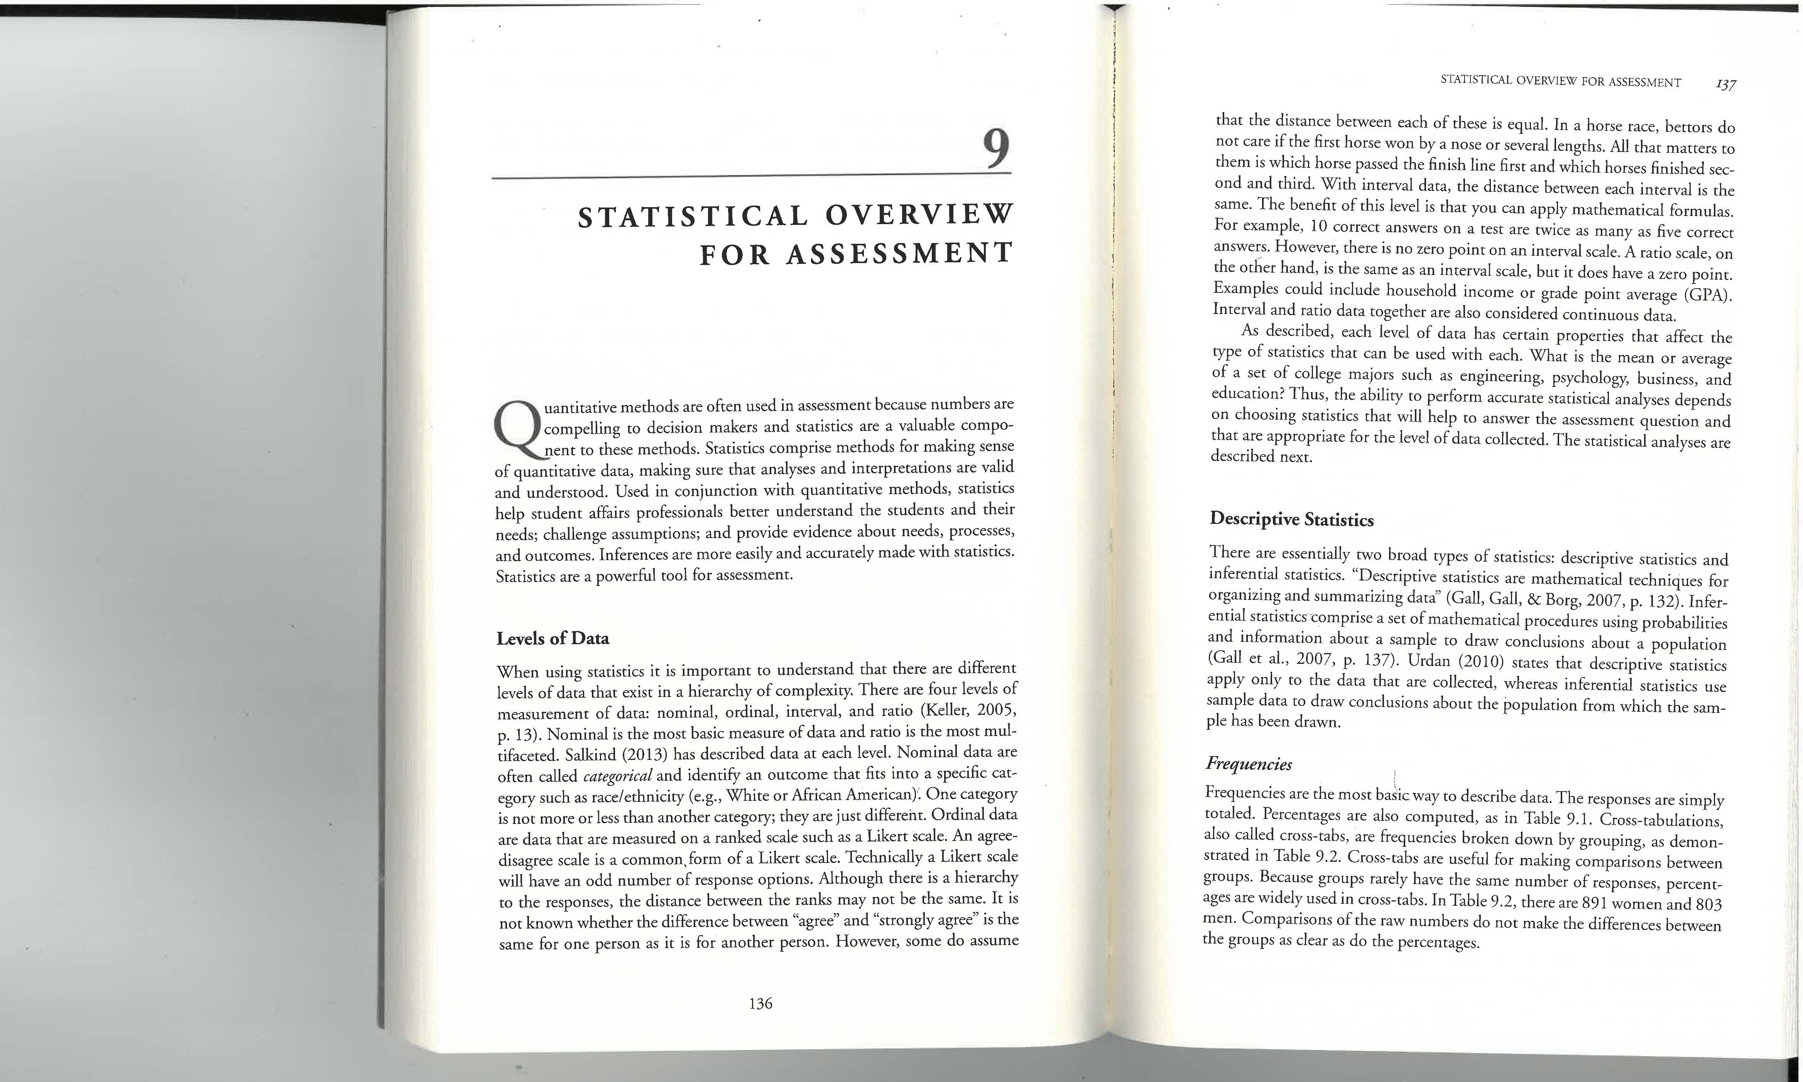
Scanned PDFs are not accessible
Use Accessibility Tool or Recognize Text

Slide 11

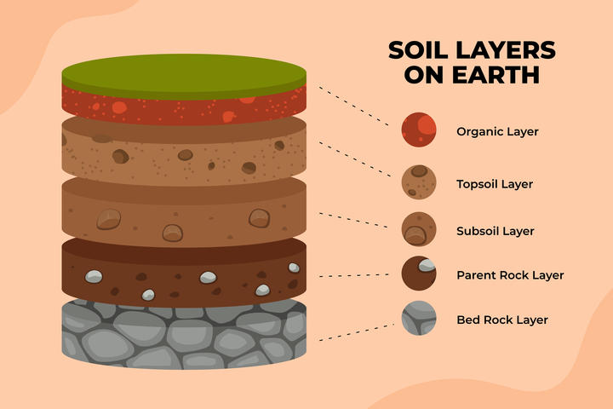

Alternative Text for Images
Alternative (Alt) Text is a brief text description of images and graphics.
When adding images, icons or other graphic elements to digital content, be sure to add alt text so that your content will be accessible to all users.
Alt Text: Print the course syllabus.
Alt Text: Group of young college students talk and walk in front of trees.
Alt Text: Diagram of Soil Layers on Earth, from top going down: organic layer, topsoil layer, subsoil layer, parent rock layer, and last bedrock layer.

Slide 12
Colors
Box 1
Box 2
COLOR CONTRAST
COLOR CONTRAST
Box 3
Box 4
COLOR CONTRAST
COLOR CONTRAST

Slide 13
Colors
Sufficient contrast between text and background colors.
Provide a description if using color to convey meaning.
Do not refer to things by just their color.
Inaccessible Example: "press the red button"
Accessible Example: "Press the square red button in the top left corner"

Slide 14
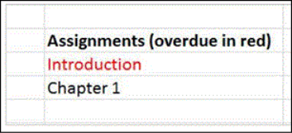
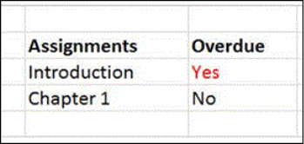
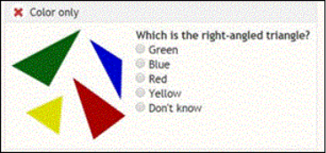
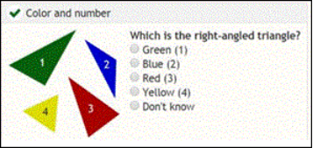
Colors- Examples
Inaccessible
Accessible

Slide 15
Accessible
Look at the academic calendar to find final exam schedules and important deadlines.
Links
Do not copy and paste links, embed them into text.
Highlight text and use keyboard shortcut "Control+K" to insert link
Make sure links have descriptive text.
Avoid using phrases such as "click here" and "visit this page."
Inaccessible
Look at the academic calendar: https://www.shepherd.edu/academic-calendar
Click Here to find the academic calendar.

Slide 16
Video and Audio Content
All audio and video content requires captioning that is 99% accurate.
This includes subtitles for everything that is verbally said and a written description of any sounds not included in the subtitles.
Audio content played in a course such as a podcast must have transcriptions available.

Slide 17
Remediation and Resources

Slide 18
Compliance Plan
Learn It
Learn the ADA Title II requirements to broaden your understanding of digital accessibility. Review the trainings and resources on our Trainings and Resource Webpage
Audit
Assess your digital content to identify what needs to be made accessible.
REMEMBER: Take your time and prioritize. Review in sections, not all at once.
Improve It
Take action to address both immediate remediation establish long term accessibility-first workflow.

Slide 19
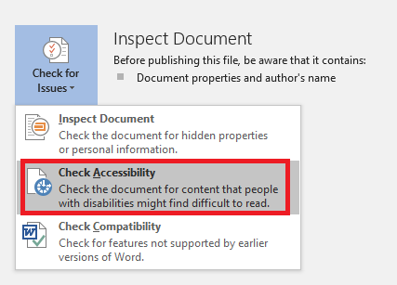
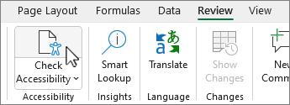
Accessibility Checkers
Programs such as Word, PowerPoint, Excel, and Google Docs have Accessibility Checking Tools.
While the tool won't fix the issue for you, it will tell you what is inaccessible and how to fix it.

Slide 20
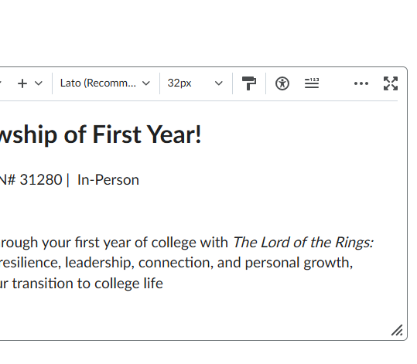
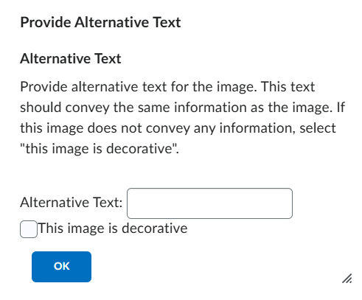
Brightspace
Utilize the Accessibility Checker in Brightspace for text and images.
Hint: Hover over the image with your mouse and the alt text will appear!

Slide 21
Digital Accessibility Resources
You are not alone!
Make sure to review the Digital Accessibility Resource page on our Faculty website.
Resources include:
Digital Accessibility Checklist
Digital Accessibility Assistance Form
How to make documents accessible
Alternative Text Generator
Resources for captioning and transcripts

Slide 22
Compliance Timeline
Education on accessible social media and websites
Education on accessible course materials.
Summer 2026-April 2027
Fall 2025
Spring 2026
Remediate materials, continuous training and resources
April 26, 2027
Meet Title II Compliance

Slide 23
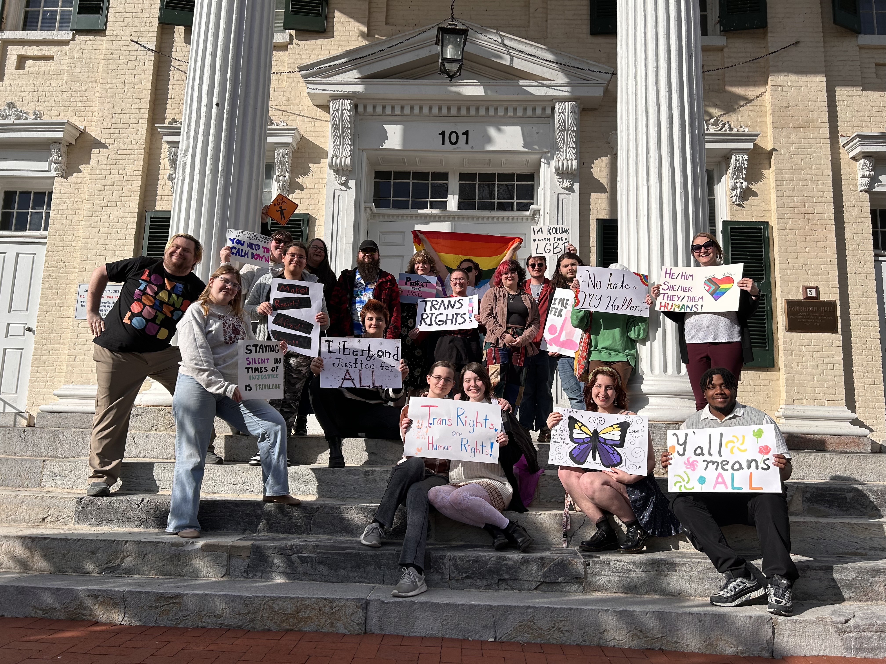
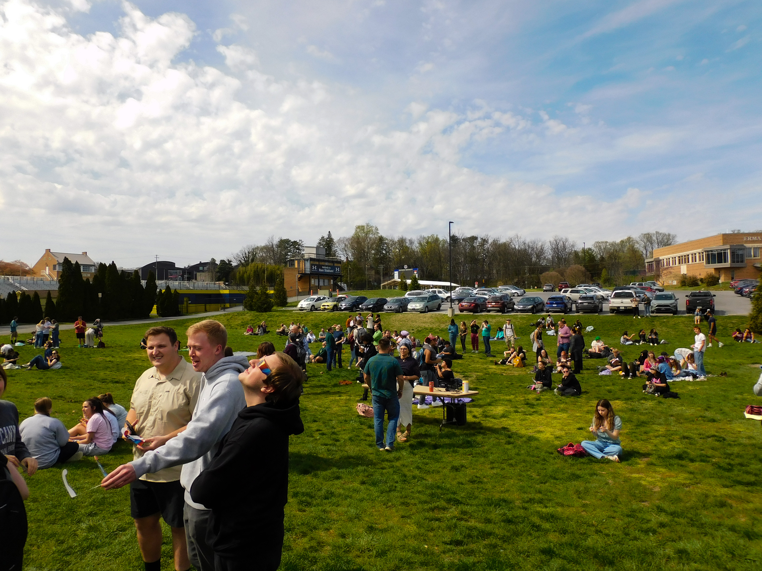
ONE Shepherd
One Mission. One Vision. One Voice.

